Slide 1

Department of ECE
EMBEDDED PROTOTYPE
Smart Door Unlocking System
GUIDED BY:-
Dr.N.PRABAKARAN Associate Professor Dept of ECE
PRESENTED BY:-
K VENKATA SAI(2300040048)
R HARSHA VARDHAN(2300040041)
D MANI SHANKAR(2300040056)

Slide 2


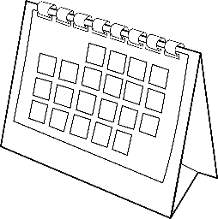
Objective
To design and develop a Smart Door Unlocking System using ESP32-CAM that enhances security by enabling face recognition–based access control, real-time image capture, and remote monitoring through Wi-Fi connectivity.
To use ESP32-CAM for capturing and processing images.
To implement face detection and recognition for authorized user identification.
To control a servo motor for automatic door unlocking.
To enable Wi-Fi-based remote access and monitoring through a web interface.
To store and manage authorized user data securely.
To reduce manual key usage and improve security with a smart embedded system.

Slide 3
Problem Statement
Traditional door locks using keys or passwords are not fully secure and can be lost, stolen, or misused. There is a need for a smart, secure, and contactless access system.
This project aims to develop a smart door unlocking system using ESP32-CAM that provides face recognition–based access control with automatic door unlocking and Wi-Fi monitoring.

Slide 4
Hardware & Software Tools
🔌 Hardware Tools / Components
ESP32-CAM – Main microcontroller with camera
FTDI Programmer – For uploading code
Servo Motor – For door locking mechanism
Jumper Wires – For connections
Breadboard – For circuit setup
5V Power Supply – To power the system
Push Button – For reset
Buzzer / LED – For status indication
💻 Software Tools
Arduino IDE – For coding and uploading program
ESP32 Board Package – For ESP32 support in Arduino
Embedded C / Arduino Programming Language – For writing code
Web Browser – For accessing live camera stream
Face Recognition Library (ESP32 library) – For user authentication

Slide 5
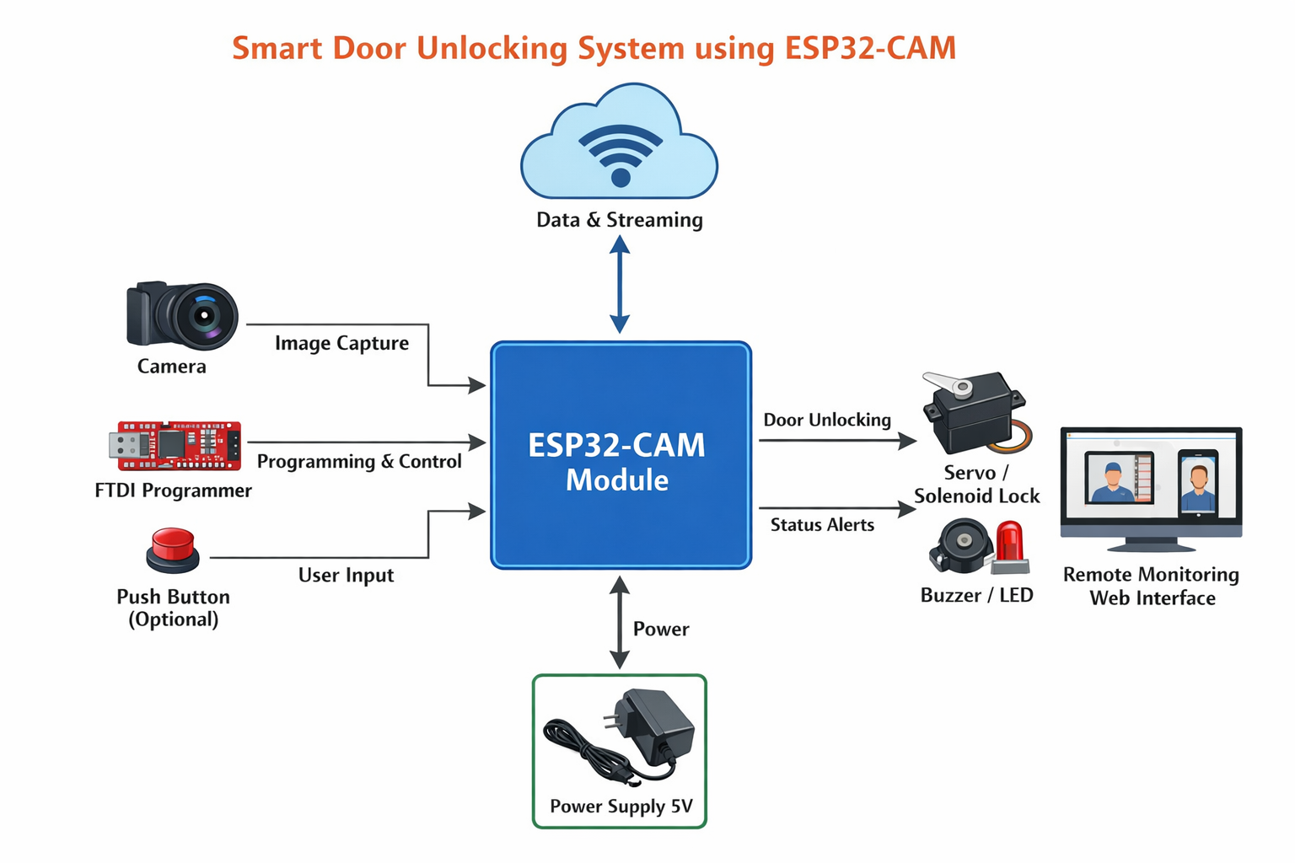
Block Diagram

Slide 6


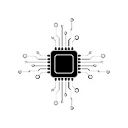


Methodology / Working
Image Capture:
The camera of ESP32-CAM captures the live image when a person stands near the door.
Face Detection & Recognition:
The captured image is processed using an embedded face recognition algorithm to detect and compare with stored authorized faces.
Authentication:
If the face matches → Access Granted
If the face does not match → Access Denied
Door Control:
A servo motor / solenoid lock is activated to unlock the door for authorized users.
Notification & Monitoring:
The system streams video via Wi-Fi and can display status through LED/Buzzer alerts.

Slide 7
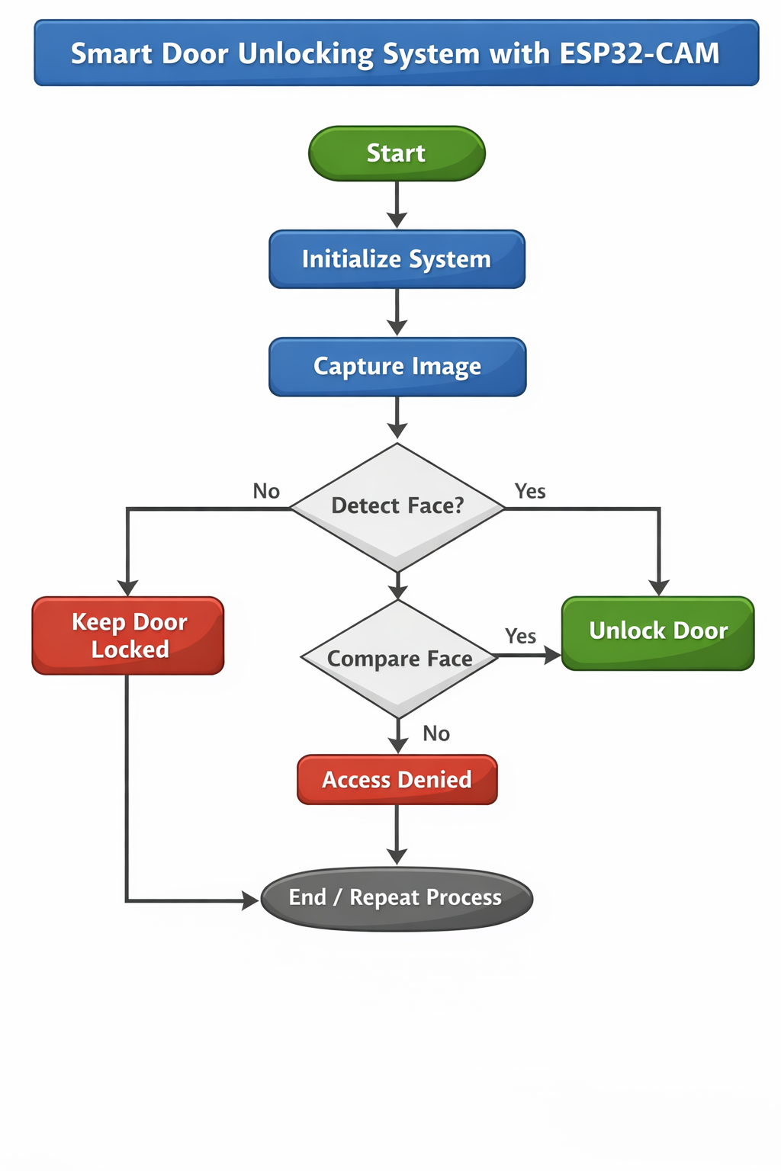
Flowchart

Slide 8
Conclusion
Conclusion:
The Smart Door Unlocking System using ESP32-CAM successfully provides a secure, automated, and contactless access control solution. By integrating face recognition technology with Wi-Fi connectivity, the system enhances security while reducing dependence on traditional keys and passwords.
The project demonstrates how IoT-based embedded systems can be used to improve safety and convenience in homes, offices, and institutions. It is cost-effective, reliable, and suitable for real-time monitoring and smart security applications.
Overall, the system achieves its objective of providing intelligent, modern, and efficient door access control.

Slide 9


THANK YOU
EMBEDDED PROTOTYPE

